Slide 1
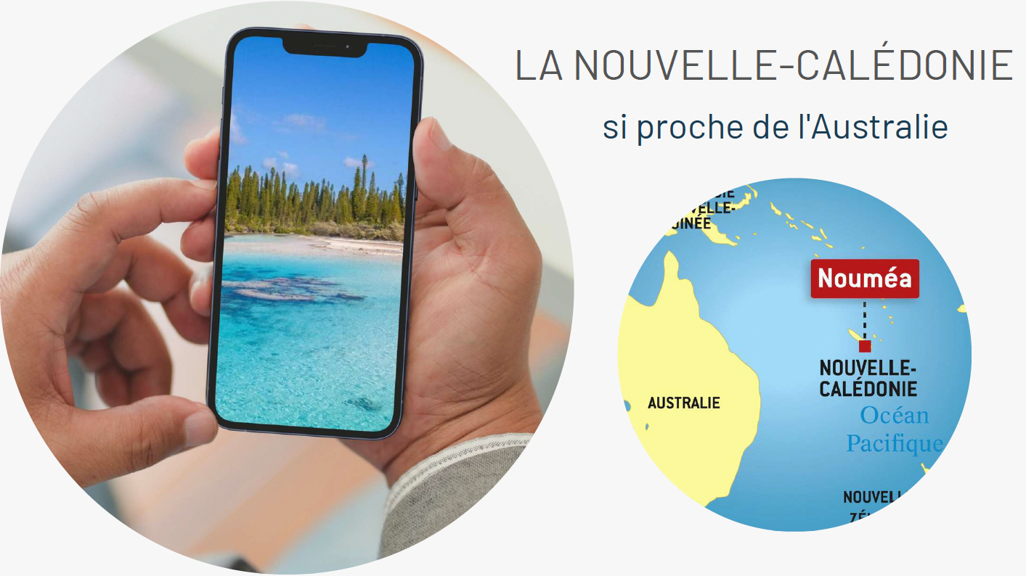
NEWS FLASH!!!!
Regional AF’s
Immersion Week
in Noumea
2/09/23 - 10/09/23

Slide 2
Spécial « Regional AF’s » - 2nd - 10th September 2023
4 Excursions /
workshops
included in
the package
Guided Visit of the
Tjibaou Cultural Centre
Guided Visit of the
penal colony
Guided Visit of the
Maritime Museum (A2)
or Atelier théâtre (B1/B2)
Workshop « Wicker Work /
Vannerie»
French Classes
15h teaching per week
2 levels :
- A2
- B1/B2
3h class every morning
(Monday to Friday)
Small Groups
(5 students per class )
Interactive Content
2 optional Full day
Excursions
Accommodation
Hotel : 2 hotels to
choose from depending
on your budget
Host Family (breakfast,
dinner & transport
included)
Visit of the Amédée
Lighthouse (Full Day)
Parc of the Blue River
(Full Day )
For
Adults
Students
Note : Air Calin is doing a Special
Fare at that time: +/- AUD 600
Departure Brisbane
Note : For hotel stays, only the room price
is included in the package
(no meals, no transport)

Slide 3
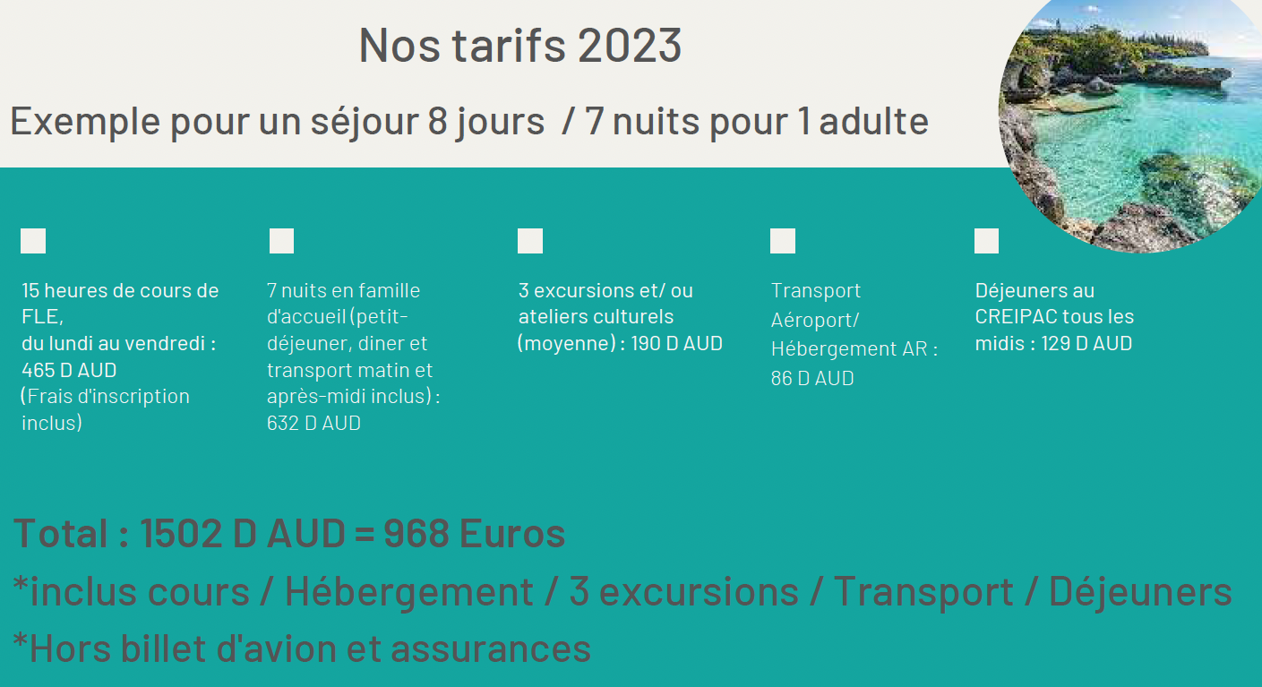
Budget - host family
Package: 9 days / 8 nights
This package includes
4 excursions
/ workshops
Included
in the package
Classes
Accommodation
Transport
Meals
Guided Visit of the Tjibaou Cultural Centre
(All levels)
Guided Visit of the penal colony
Guided Visit of the Maritime Museum (A2)
or Atelier théâtre (B1/B2)
Workshop « Wicker Work / Vannerie»
+/- 110.00
Airport Transfer
Return
+/- 95 AUD
1 Welcome Breakfast CREIPAC
Lunch at CREIPAC
4 days
(big salad, water & homemade cake)
Lunch at Host Family
2 days
Total :
+/-175 AUD
15 hours of FLE classes
Monday to Friday
+/- 375 AUD
8 nights in a host family
(breakfast, dinner &
transport morning
& afternoon included
- to & from CREIPAC)
+/- 770 AUD
Special Regional
AF Network
Students only have to add their flight fare and their personal expenses….
Note : Air Calin is doing a Special
Fare at that time: +/- AUD 600
Departure Brisbane
Budget for students :
+/- 1,650.00 + Flight
(administration fee included)

Slide 4
Budget - Nouvata Hotel
Package: 9 days / 8 nights
This package includes
5 excursions
/ workshops
Classes
Accommodation
Transport
Meals
8 nights at the
Nouvata Hotel
in a standard room
+/- 1,060 AUD
(Meals not included)
Room : 25m2 (3px max)
Air Cond - Kitchenette with fridge & microwave-
TV - desk - Limited Wifi
(Limit of 250Mo per day per room)
Guided Visit of the Tjibaou Cultural Centre
(All levels)
Guided Visit of the penal colony
Guided Visit of the Maritime Museum (A2)
or Atelier théâtre (B1/B2)
Workshop « Wicker Work / Vannerie»
+/- 110.00
Airport Transfer
Return
+/- 95 AUD
+
Transport
to & from CREIPAC
from the hotel
+/- 115 AUD
1 Welcome Breakfast CREIPAC
Lunch at CREIPAC
4 days
(big salad, water & homemade cake)
Total :
+/-135 AUD
15 hours of FLE classes
Monday to Friday
+/- 375 AUD
Special Regional
AF Network
Students have to add their flight fare, their meals at the hotel and their personal expenses….
Note : Air Calin is doing a Special
Fare at that time: +/- AUD 600
Departure Brisbane
Note : Continental Breakfast
at the Nouvata costs +/- 40
Budget for students :
+/- 2,000.00 + Flight
(administration fee included)

Slide 5
Budget - Le Lagon Hotel
Package: 9 days / 8 nights
This package includes
5 excursions
/ workshops
Classes
Accommodation
Transport
Meals
8 nights at the
LE LAGON HOTEL
in a studio
+/- 1,385 AUD
(Meals not included)
Room : 22m2
King Size bed - Terrasse -
Kitchenette with fridge & microwave
Terrasse - Hi Speed Internet
Guided Visit of the Tjibaou Cultural Centre
(All levels)
Guided Visit of the penal colony
Guided Visit of the Maritime Museum (A2)
or Atelier théâtre (B1/B2)
Workshop « Wicker Work / Vannerie»
+/- 110.00
Airport Transfer
Return
+/- 95 AUD
+
Transport
to & from CREIPAC
from the hotel
+/- 115 AUD
1 Welcome Breakfast CREIPAC
Lunch at CREIPAC
4 days
(big salad, water & homemade cake)
Total :
+/-135 AUD
15 hours of FLE classes
Monday to Friday
+/- 375 AUD
Special Regional
AF Network
Students have to add their flight fare, their meals at the hotel and their personal expenses….
Note : Air Calin is doing a Special
Fare at that time: +/- AUD 600
Departure Brisbane
Note : Traditional Breakfast
at Le Lagon costs +/- $25
Budget for students :
+/- 2,350.00 + Flight
(administration fee included)

Slide 6
Optional Costs
Additional excursions :
Sunday 3rd September = All day excursion at the Amédée Island Lighthouse - Budget +/- 175.00
Saturday 9th September = All day excursion at the Parc de la Rivière Bleue - Budget +/- 180.00
The team at CREIPAC will give you tips on additional activities
Special Regional
AF Network
Food :
There is a bakery not far from the hotels, should you prefer to grab a coffee and
a croissant/pain au chocolat before your class instead of the hotel breakfast

Slide 7
Terms & Conditions
For homestay students, if your flight lands after 4pm, you will need to spend the first night
at a hotel.
The prices shown on this document are based on current exchange rates.
Amounts can vary slightly, due to exchange rates fluctuations.
These package were put together by our associated school CREIPAC , the best address for
Immersion Stays in the Pacific.
This offer is exclusive to AF members & Adult students.
Early Bookings are recommended as Places are Limited
Deadline for Booking any of these packages is 30th April 2023. A payment of $100 is required to secure your booking and cover the administration fee.
Special Regional
AF Network
Students must book their own Air Fares (allowing them to arrive earlier and/or depart later in the week).
Cécile will accompany the students departing from Brisbane (Saturday 2nd September - time of flight to be confirmed). The return flight will be on Sunday 10th September - time of flight to be confirmed)
Payment for the course, the accommodation, the food and the excursions will be processed in Noumea , upon your arrival.
Once you have chosen your package, you will receive an application form to fill in & return to Cécile.

Slide 8
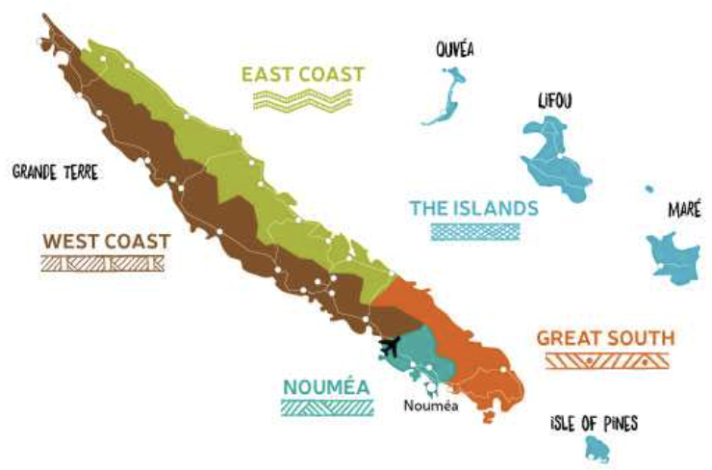
Useful Links
CREIPAC
https://www.creipac.nc/en/homepage-4/
NOUVATA
https://www.nouvata.nc/fr/chambres.html
LE LAGON
https://lelagon.nc/room_type/studio-chambre-hotel-noumea/
THE LIGHTHOUSE
https://amedeeisland.com/amedee-lighthouse/
TJIBAOU CULTURAL CENTER
https://www.newcaledonia.travel/nz/noumea/tjibaou-cultural-center
NEWS FLASH!!!!
PENAL COLONY
https://www.newcaledonia.travel/nz/west-coast/moindou/fort-teremba
Regional AF’s
Immersion Week
in Noumea
2/09/23 - 10/09/23
MARITIME MUSEUM
https://museemaritime.nc/english/
PARC OF THE BLUE RIVER
https://www.newcaledonia.travel/nz/great-south/yate/blue-river-park

